Slide 1
Technology in science classes

Slide 2
Technology in Science Classes
What type of technology are you using in your class?

Slide 3
Technology options
Online software for assessments
Digital probes
Digital camera
Online discussion platforms
Websites
Laptops, tablets.
Communications
Notes:
Our classrooms are changing, and without a doubt they will look quite different in five or ten years than they do today. New technologies are being developed quickly, But technology in such abundance is not education’s magic bullet.
Technology can open doors, expand minds, and change the world. Technology can enrich your instruction, make your job easier and faster. It helps you deliver your instruction more effectively.
However, it’s not going to replace a teacher anytime soon.
They are leaders, guides, facilitators, and mentors. They encourage students when they struggle, and inspire them to set and reach for their goals.
They are role models, leading by example and giving direction when necessary.
So yes, technology is going to play a critical role in the future of education. But not as big a role as that of a teacher.

Slide 4
Plickers
Class respond system that lets teachers collect real-time formative assessment data without the need for student devices
https://www.youtube.com/watch?v=DfUB05xiIGM

Slide 5
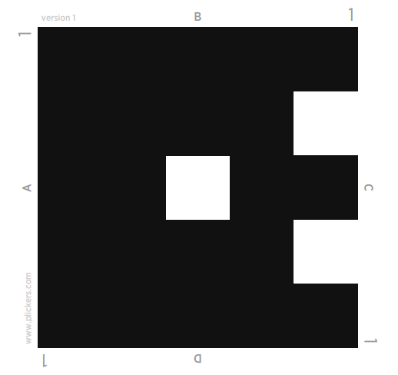
PLICKER
Sign up for plickers.
Create your class and add students
Assign one plickers card for each student
Students rotate cards and hold their response at the top
Teacher scans the cards with a mobile or a tablet device through plickers app.

Slide 6
Plickers
Who is the new president of the US?
A Donald Trump
B Barack Obama
C Hilary Clinton
D Dincer Coach

Slide 7
Socrative online assessment system
Quickly assess students with prepared activities
On-the-fly questions to get immediate insight into student understanding.
Then use auto-populated results to determine the best instructional approach to most effectively drive learning.

Slide 8
Socrative online assessment system
Works as an app or in any browser.
Type your questions using the app or the software.
Upload your questions and the answer key using an excel sheet.
Type your questions in the excel sheet
Hand out your questions in hard copies, and just collect the correct choices.

Slide 9
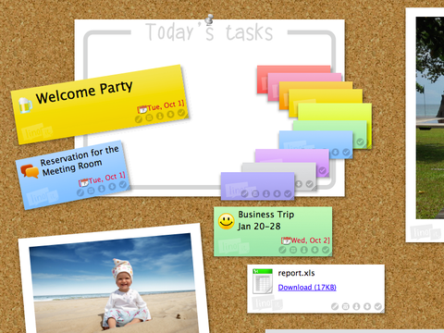
Sticky wall
www.linoit.com
Post comments on sticky wall
Go to goo.gl/hgCSwH
Post your comment for
DOES A TREE DIE OF OLD AGE?

Slide 10
Poll everywhere
Ask your students a question with the Poll Everywhere app
Your students answers in real time using mobile phones, Twitter, or web browsers
See your response live on the web or in a PowerPoint presentation
Text DINCERCOACH602 to 37607
Then answer the poll question
OR
Respond at PollEv.com/dincercoach602

Slide 11
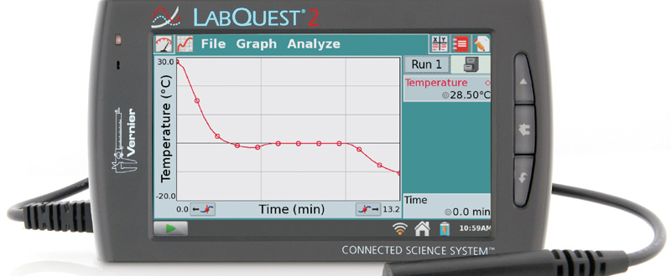
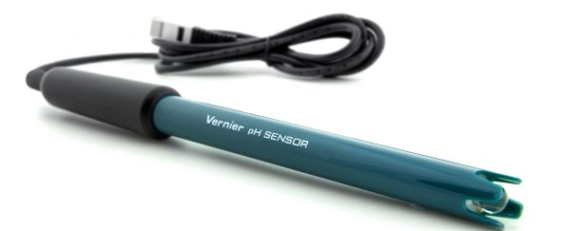
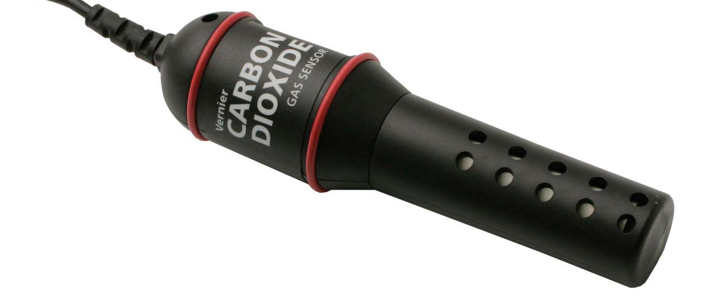
Digital probes
Use Vernier or Pasco Probes used to collect, analyze, and interpret scientific data.

Slide 12
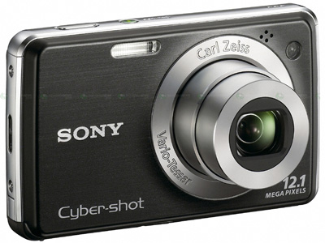
MOTION animations
Use digital cameras to create motion animations
http://betterlesson.com/lesson/resource/3270748/mitosis-student-sample-3-video

Slide 13
Online Discussion Platforms
Edmodo
Schoology
Backchannel Chat
Collaborize Classroom
Chalkup

Slide 14
Create your own website or WIKI
Publish your students’ work
Publish class assignments and/or class resources.
https://sites.google.com/a/conceptschools.org?pli=1
https://wordpress.com/
http://www.wikia.com/Special:CreateNewWiki

Slide 15
Use Twitter
Create a private class account that students log into.
Use #hashtags to organize work, “reply” to group answers in one spot.
Show it on the class Smartscreen throughout class and encourage students to post inquiry-related comments, thoughts and questions for the class.
CLASSROOM TWITTER SET UP - INSTRUCTIONS
https://grouptweet.com/blog/step-by-step-guide-to-managing-a-classroom-twitter-account-with-grouptweet

Slide 16
Listen to – or create – a Podcast.
Search for ones that meet your students’ needs.
Some colleges are offering professors’ lectures via podcast, which can be great for advanced students.
Have students create their own podcasts to document their progress through the year or discuss their ideas on a variety of issues pertaining to the course.
http://www.sciencepodcastforkids.com/
http://www.brainson.org/
Find more podcasts at https://medium.com/@_lindsayp/19-great-science-podcasts-you-can-listen-to-with-kids-6fe46ac506b8#.em0m8jgba

Slide 17
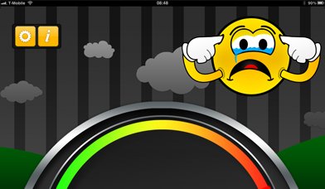
Control a noisy classroom
Show a tool (like Too Noisy) on the class Smartscreen that tracks noise in the classroom.
This requires nothing from you -- just the display.
Students naturally react to the noise meters.

