Slide 1
Classroom Design
Sevgi Gencler Artykowa

Slide 2
classroom design that promote thinking
Learning is an ecology. Classroom design impacts classroom management impacts curriculum needs impacts lesson and unit design impacts teacher personality impacts teaching strategies, and so on.

Slide 3
5 categories
Classroom layout
Color
Classroom bulletin boards
walls
light

Slide 4
1) Layout
improvements to classroom layouts, like creating space for independent work or making a clear pathway to access school supplies result in a
45 % increase in academic engagement

Slide 5
2) Color
purposeful use of color in classrooms and schools can decrease eye fatigue and increase student's productivity.

Slide 6
a) red
positive: active, strong, grabs and focuses attention
negative:aggressive, and intense

Slide 7
b) yellow
positive: cheerful, highly visible due to the amount of light reflected
negative: may lead to eye fatigue

Slide 8
c) green
positive: relaxing, quiet, grabs attention, and increases creativity
negative: boredom, blandness

Slide 9
d) blue
positive: comfort, security, grabs attention, increases creativity
negative: coldness, aloofness

Slide 10
3) classroom bulletin boards
Motivate students, by letting them know that their best work will be displayed on your classroom bulletin boards.
You should always divide up your bulletin boards in the classroom to display different material in your curriculum - whether it's your information or the students' work on a specific topic. Want some suggestions - students' art, creative stories written by the students, science diagrams, pictures and information on a unit. One more thing, - students love to help put up their work, so definitely let them!

Slide 11
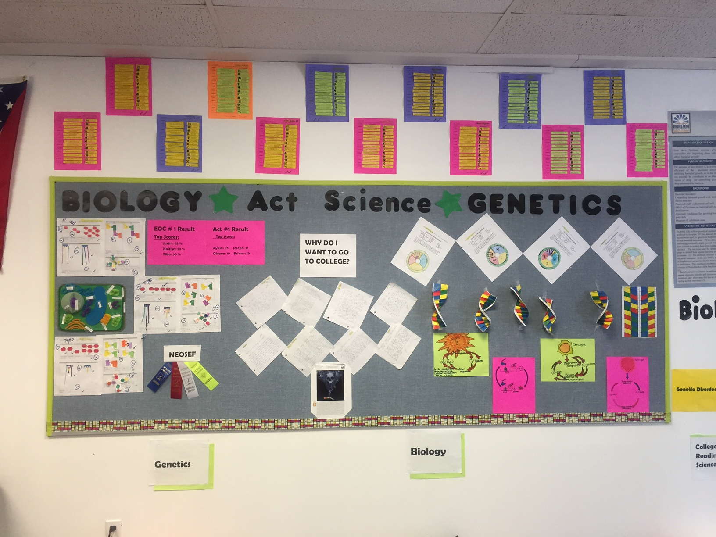

Slide 12
4) Walls
removing clutter on the walls and personalizing student spaces are easy ways to improve student focus, engagement, and memorization.
keep 20-50 % of wall space clear to optimize student learning
neutral background colors such as beige or white help students focus on the lesson, not the walls
factors such as visual clutter and crowding can distract students.

Slide 13
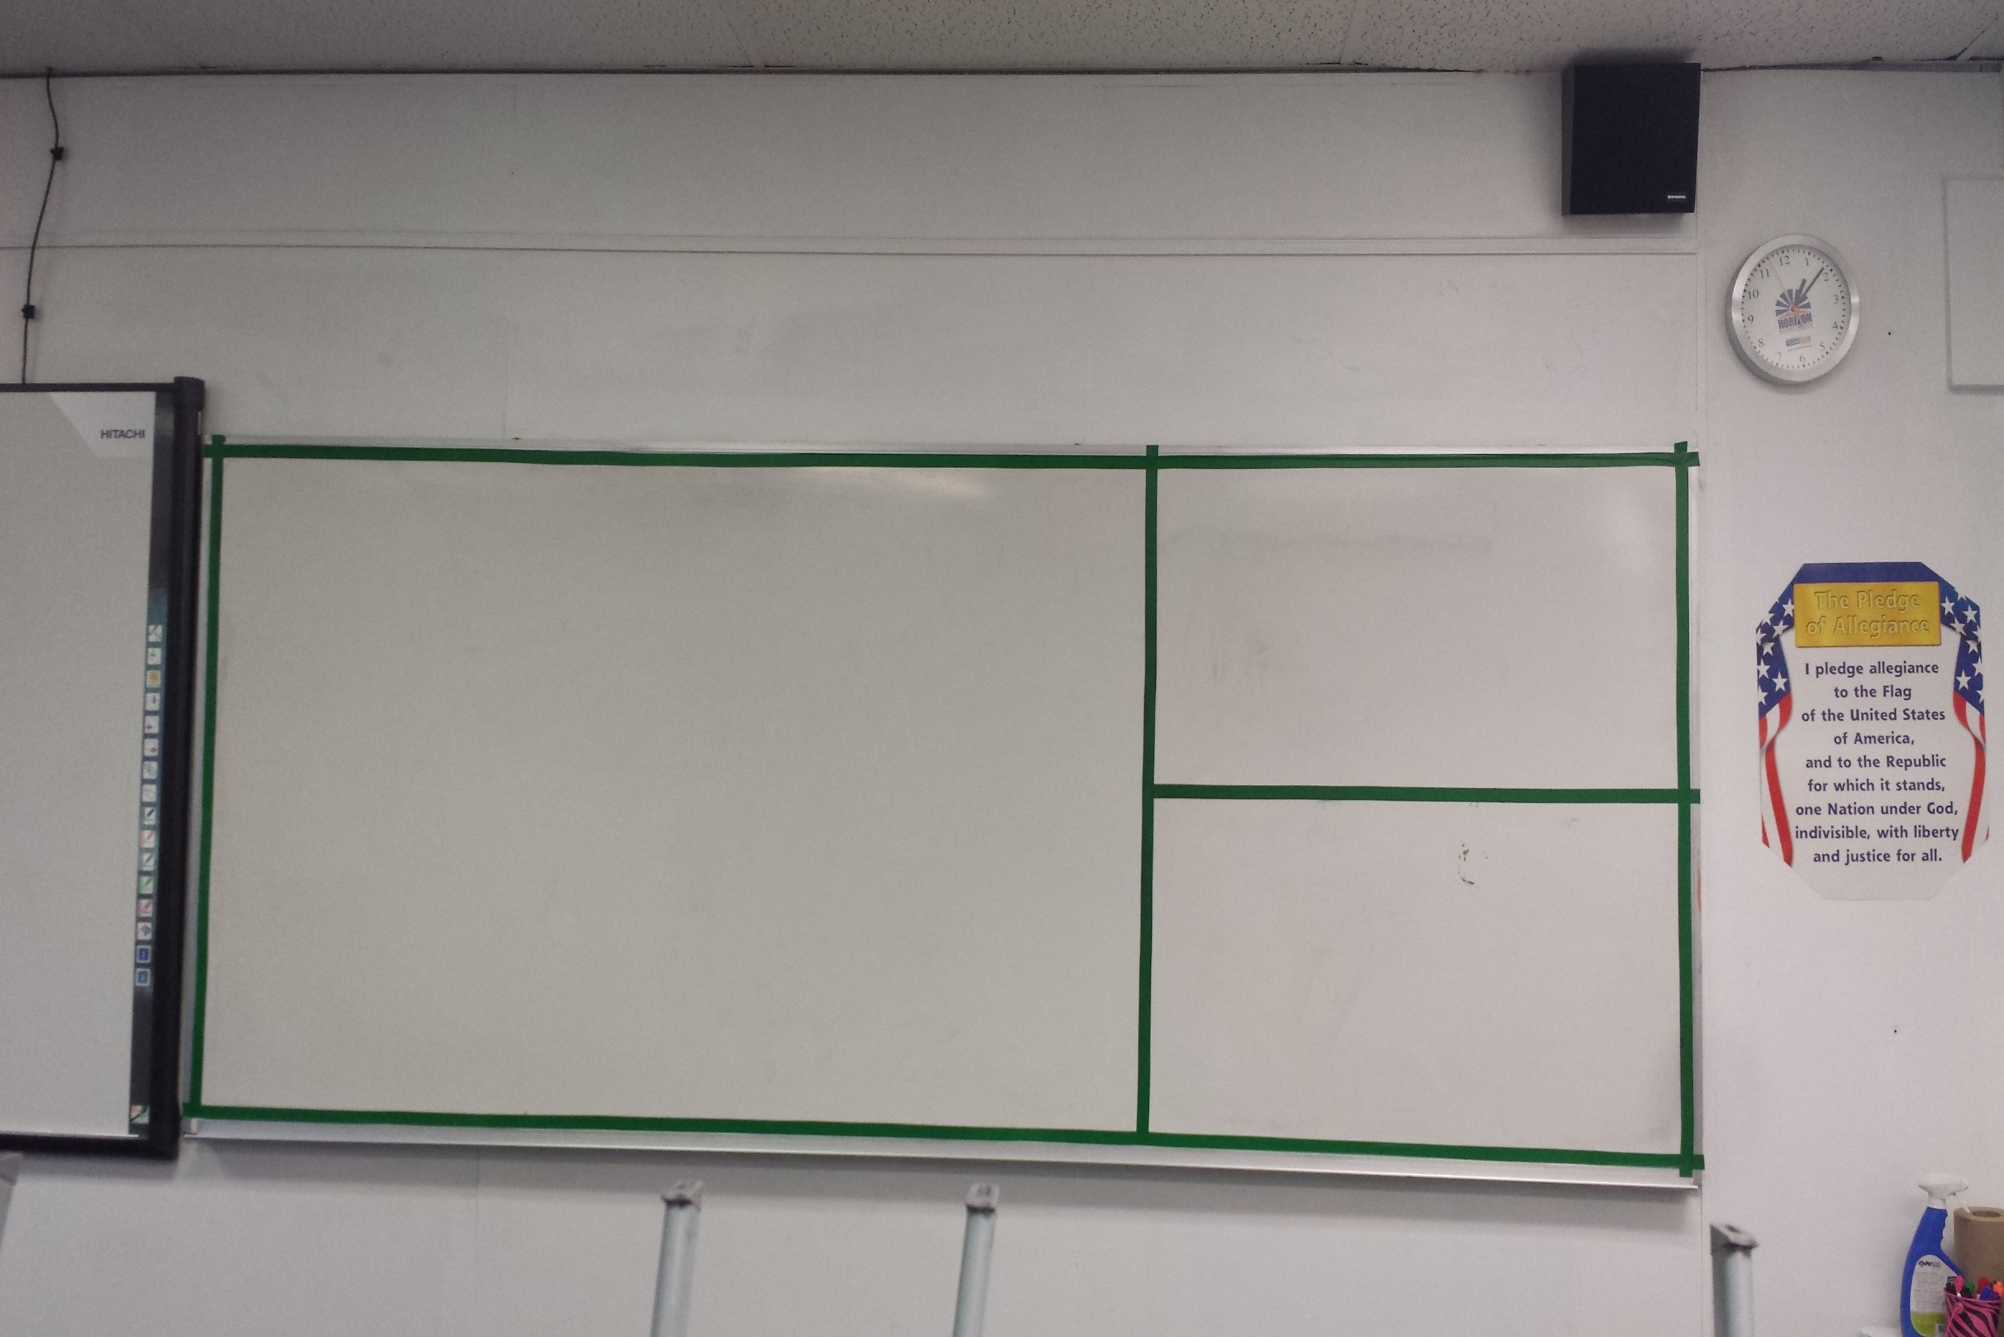

Slide 14
5) Light
students who are exposed to more daylight in the classroom score 26% higher on math and reading tests than whose less exposure to light.
keep windows clear of displays or furniture
keep blinds open unless needed to reduce glare
use electric light to supplement nature light
use lamps to create a warm atmosphere in smaller areas like reading nooks.

Slide 15
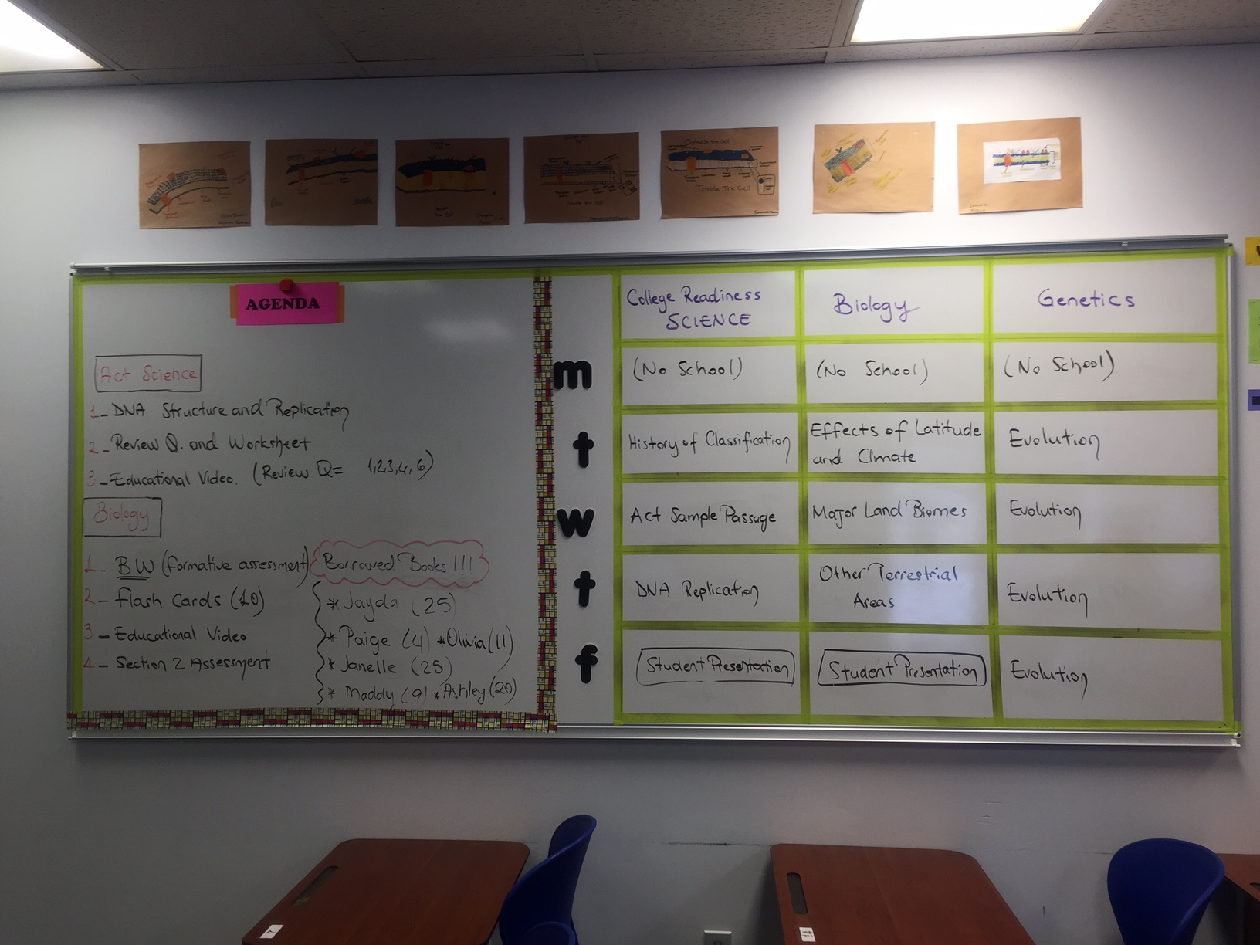

Slide 16
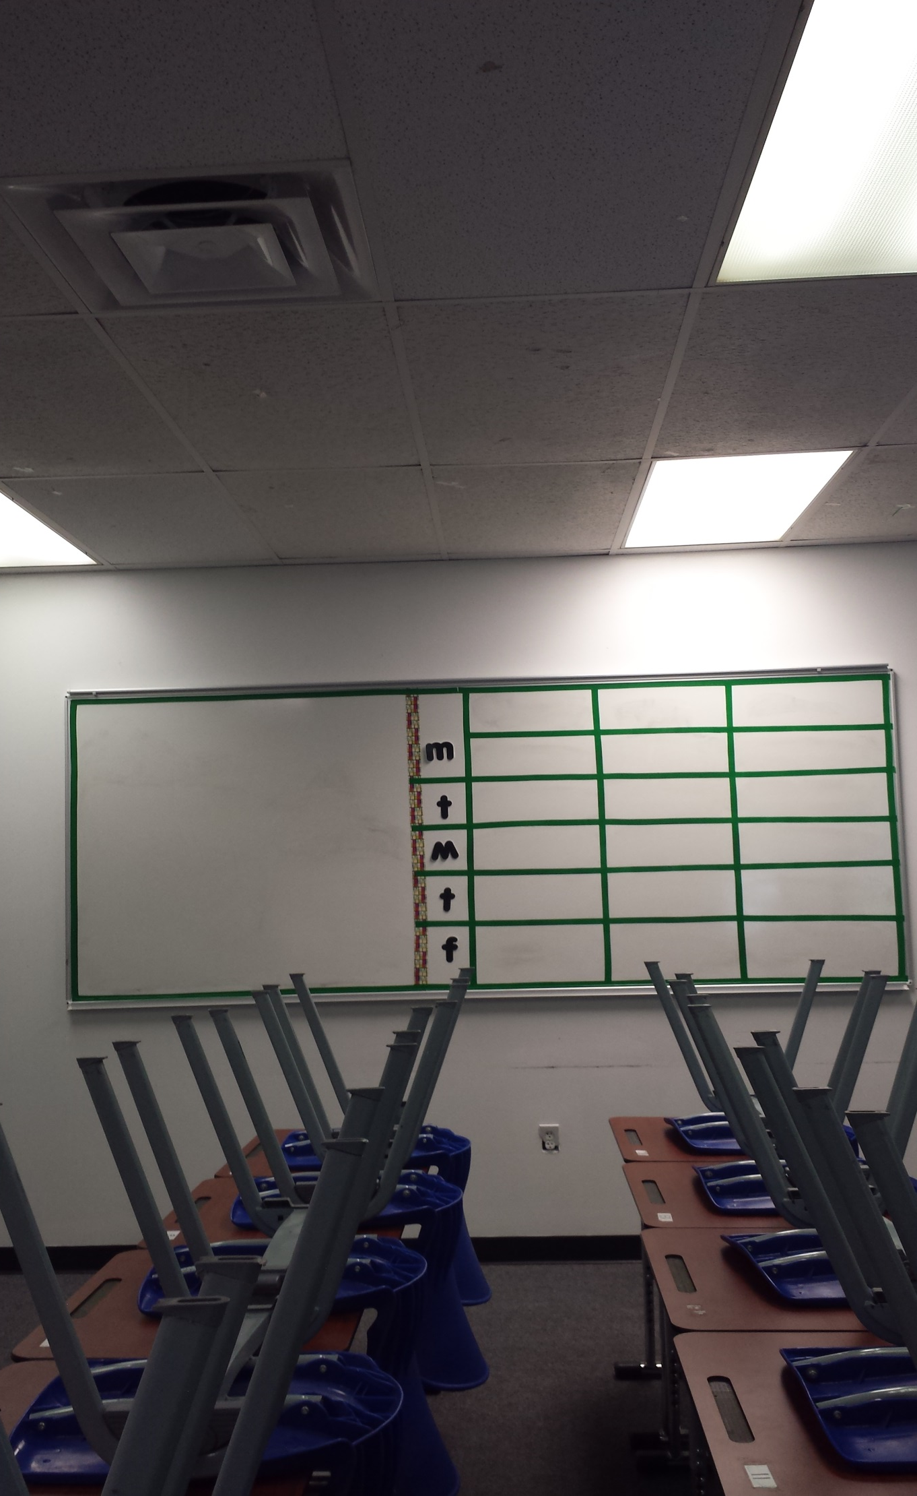

Slide 17
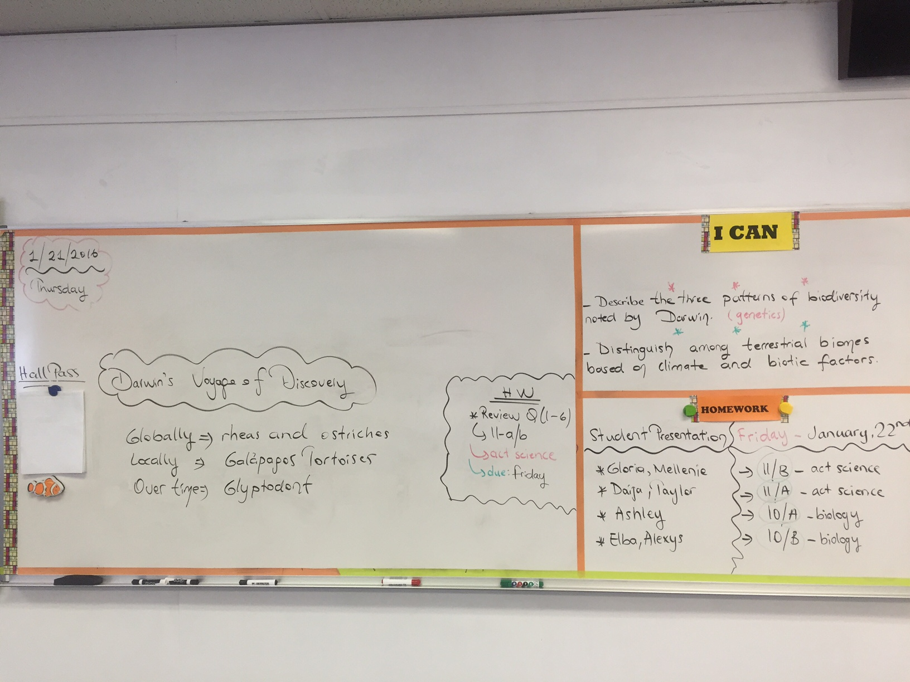

Slide 18
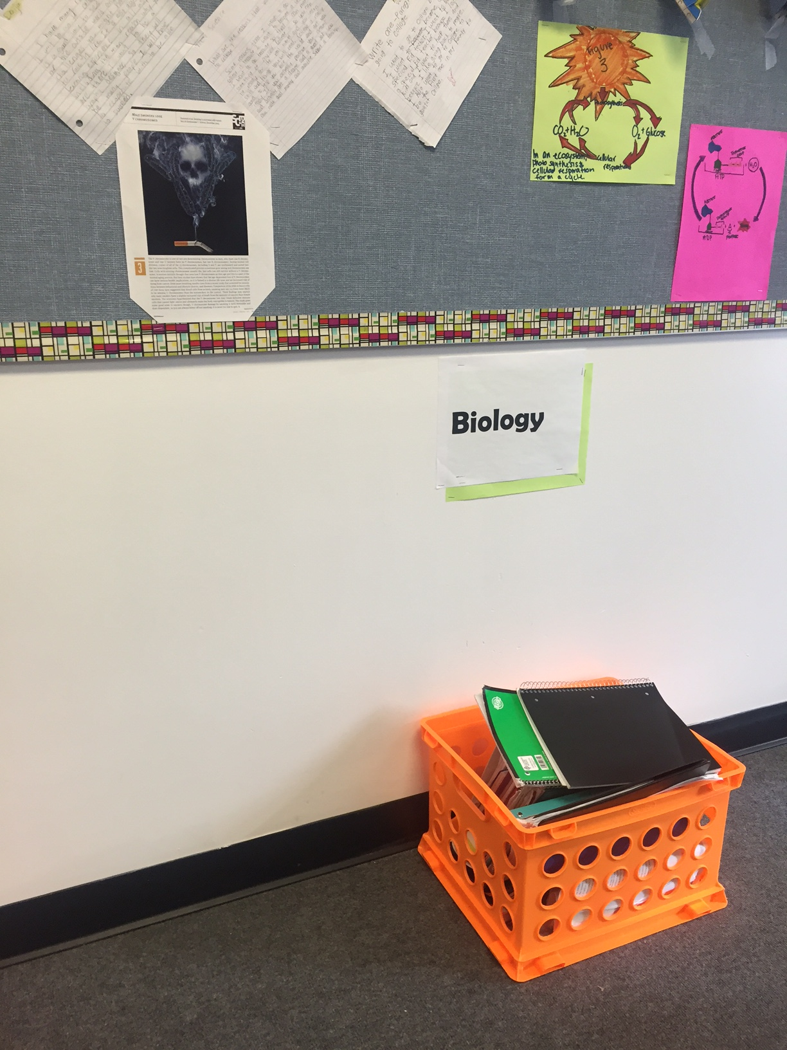

Slide 19
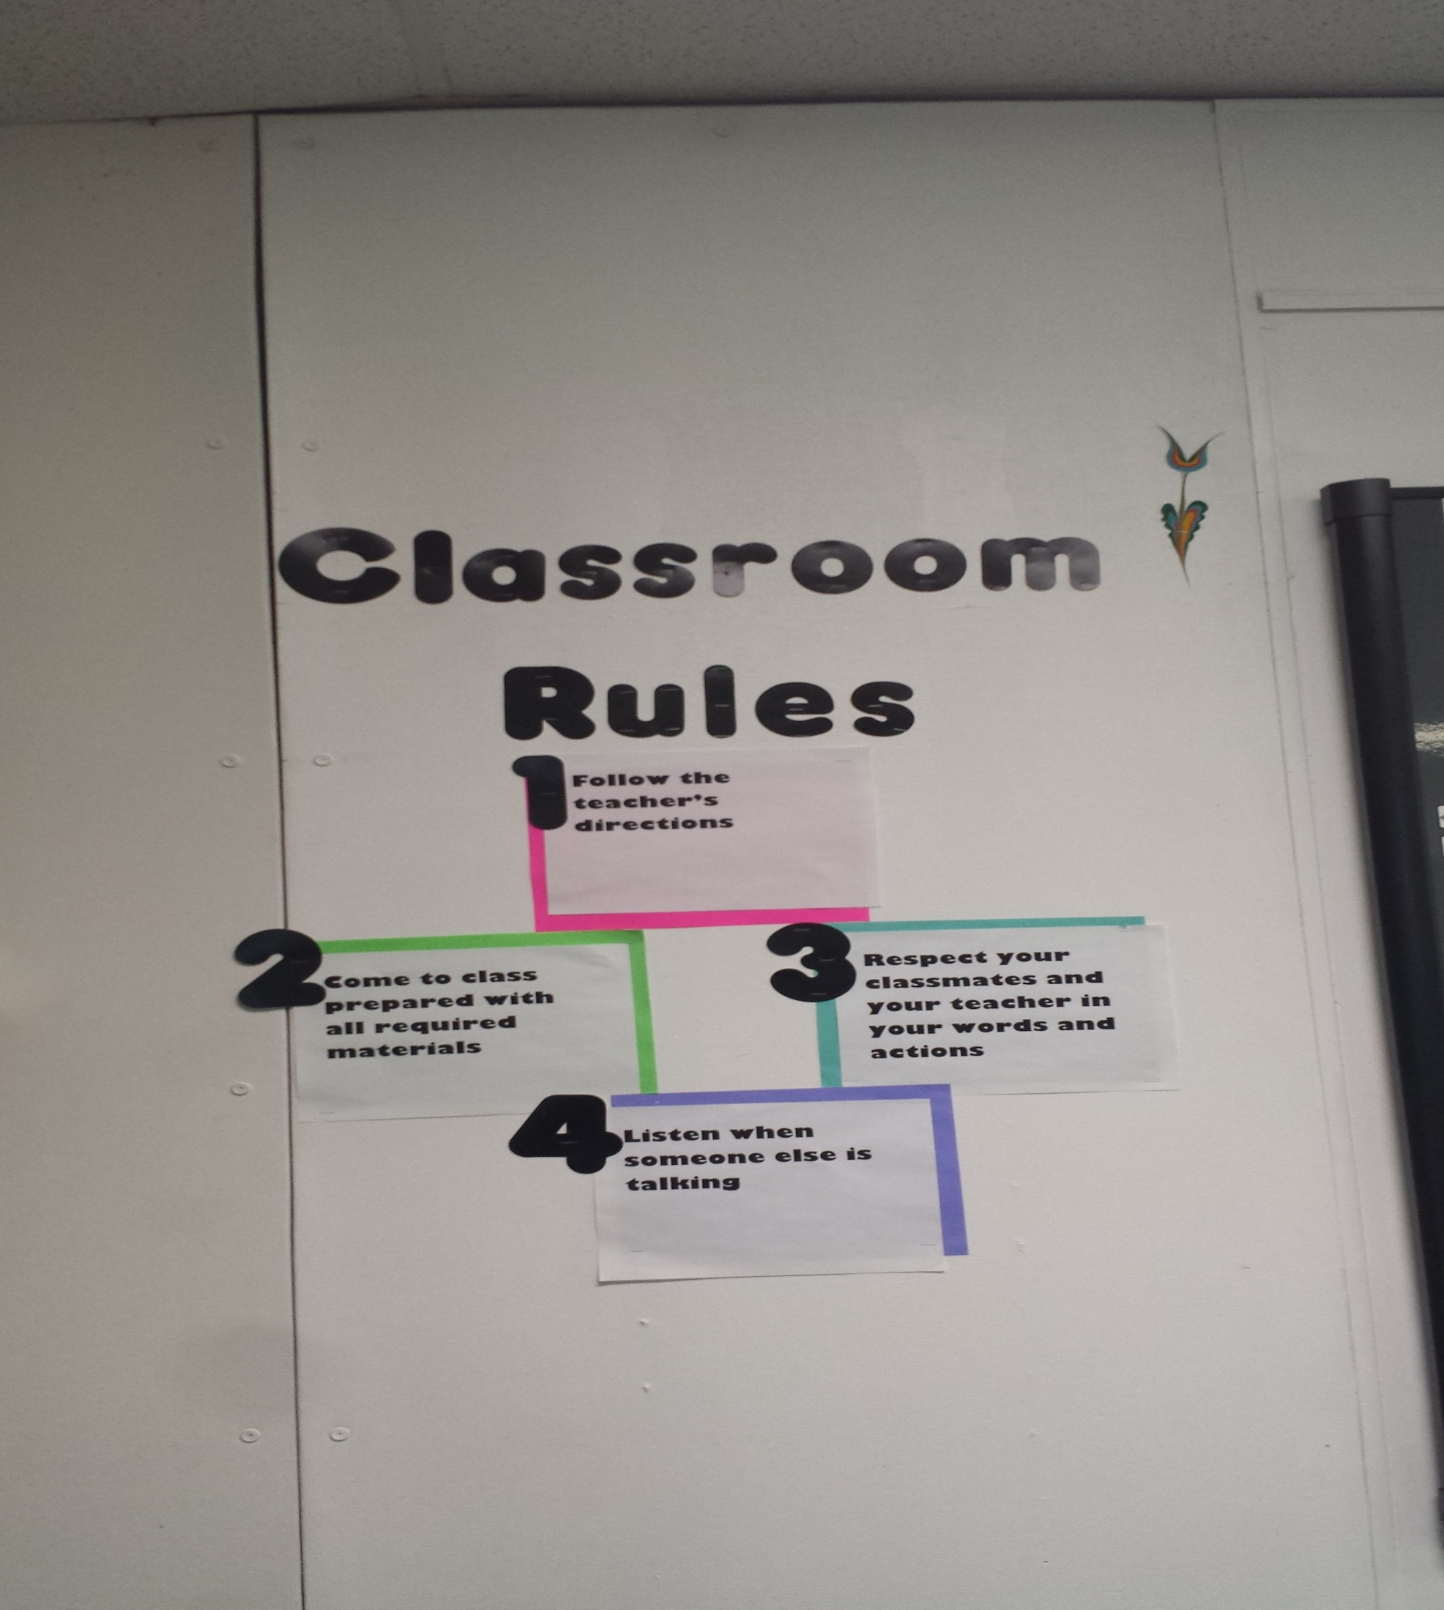

Slide 20
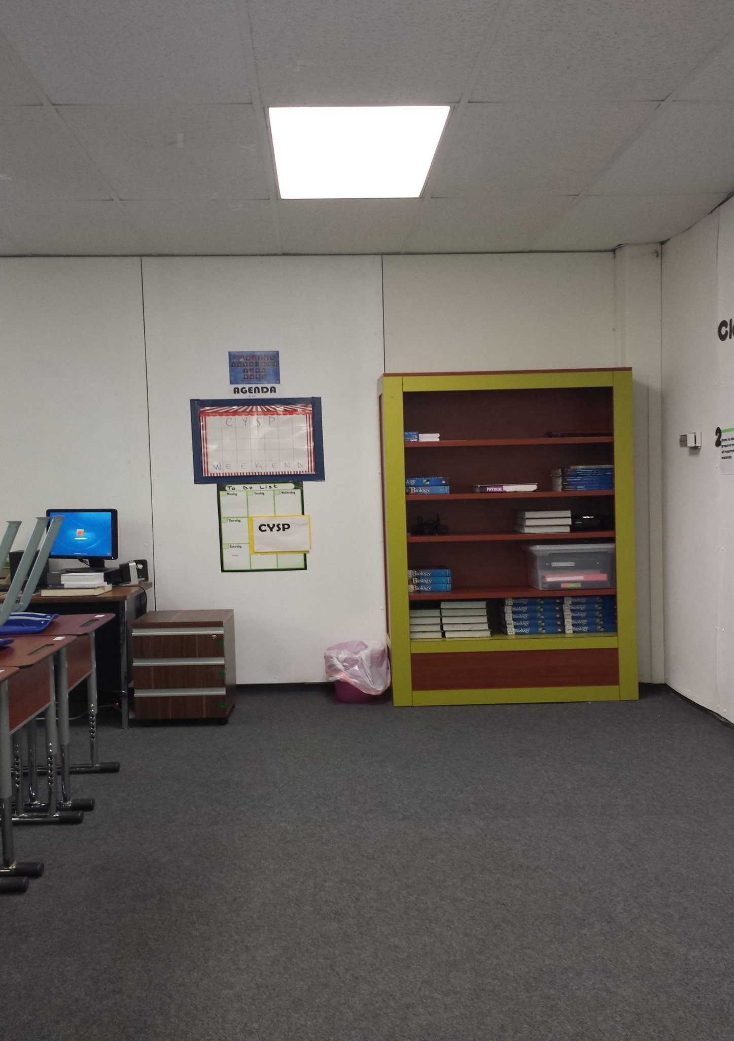

Slide 21
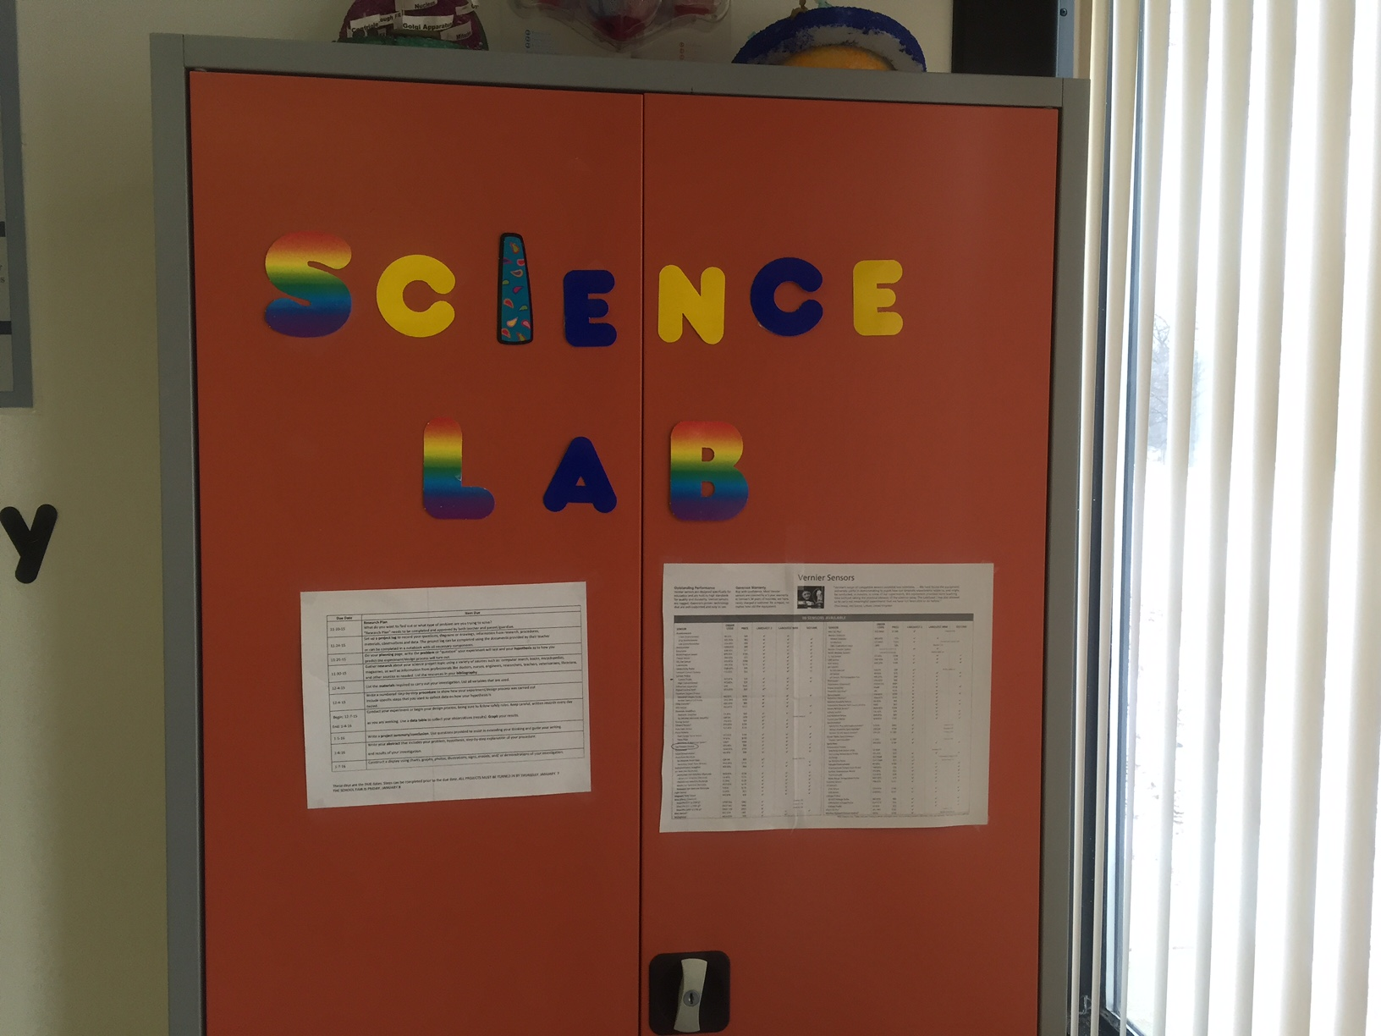

Slide 22
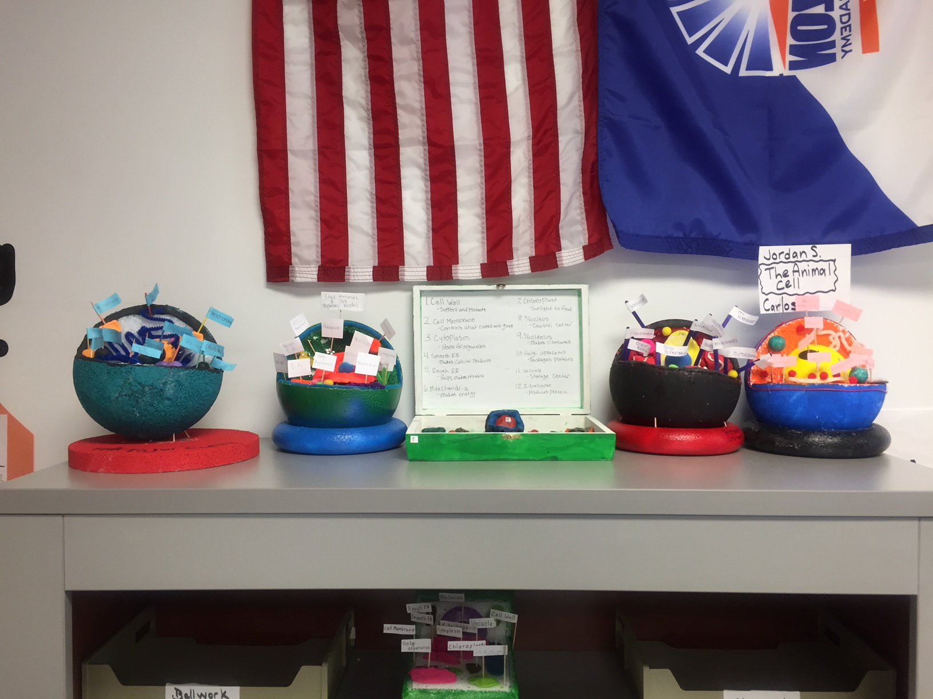

Slide 23
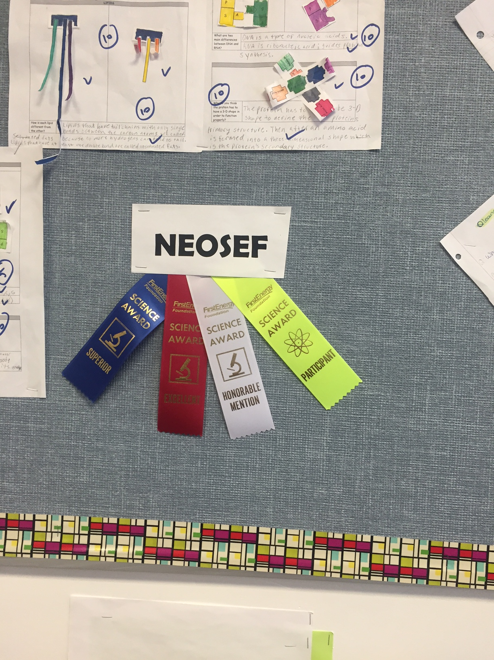

Slide 24
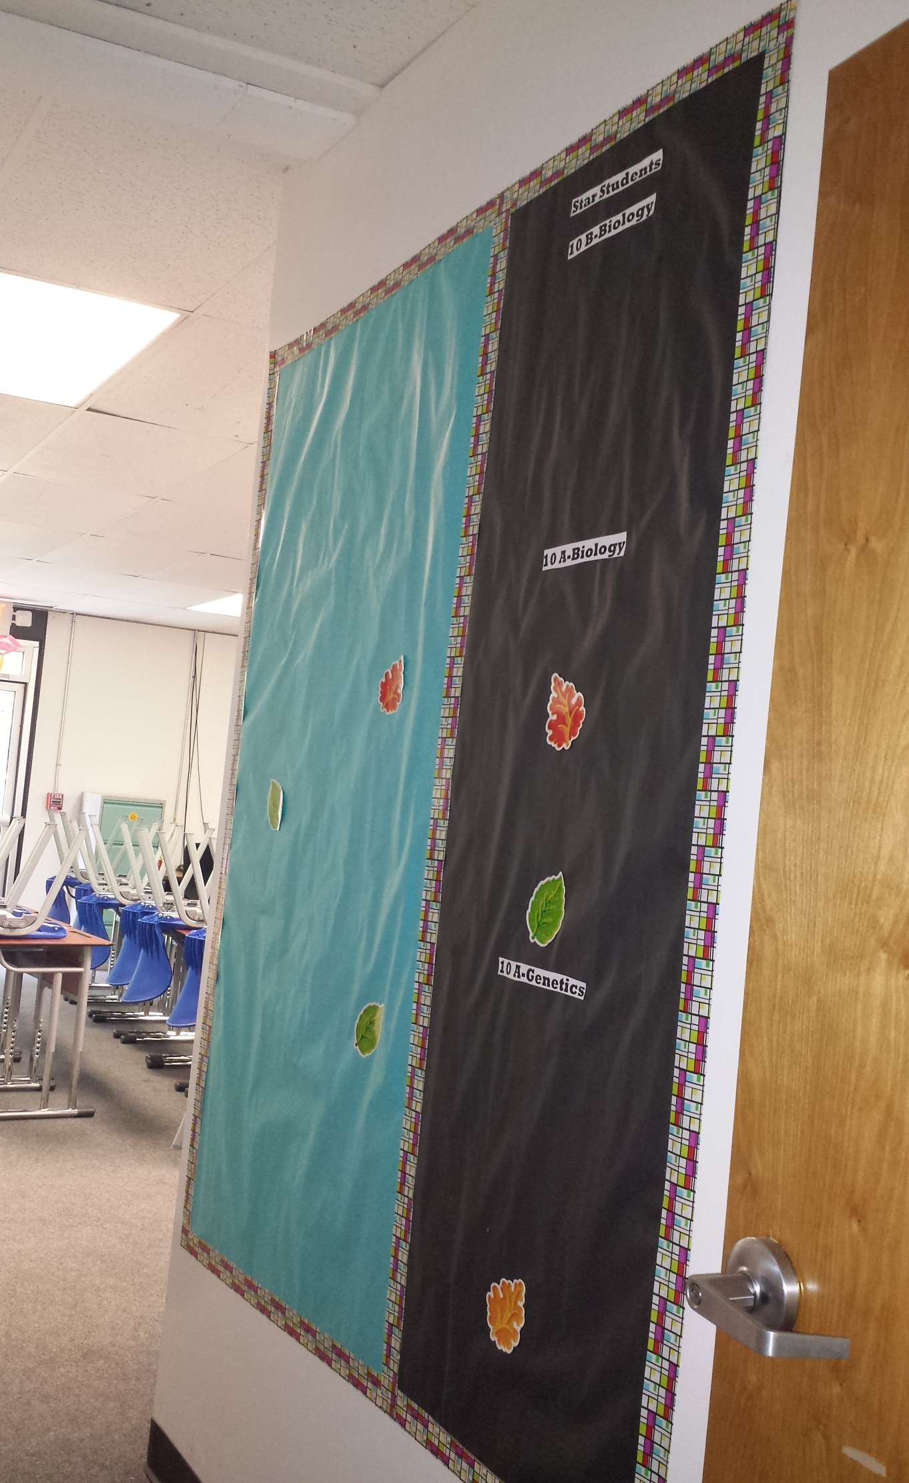

Slide 25
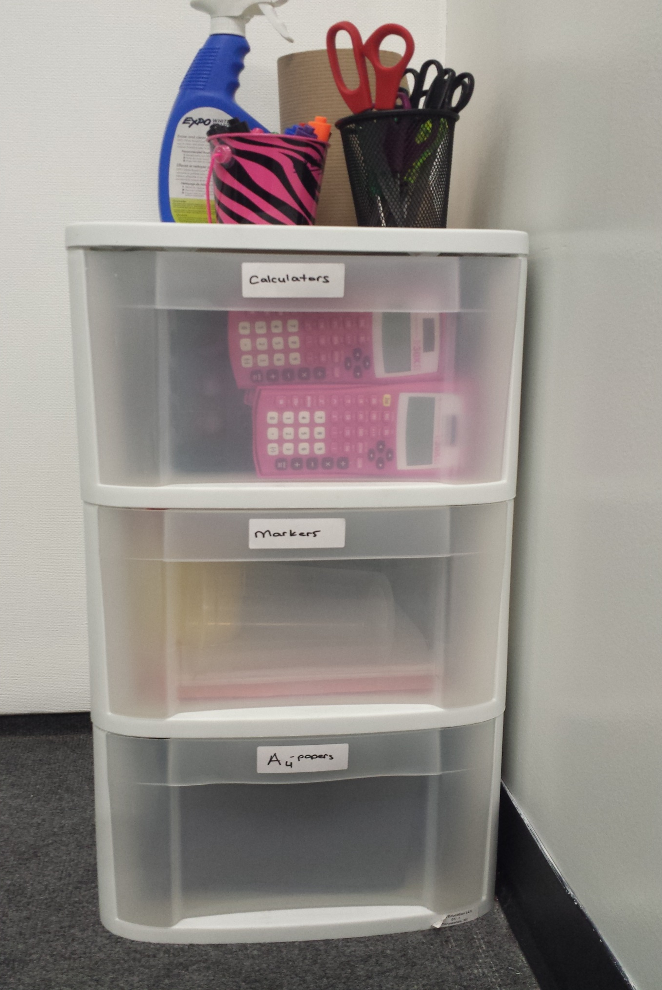

Slide 26
